Slide 1
INF10002 Database Analysis and Design
Week 01
Overview, Relational Model,
RDBMS, Database, MS Access, Table, Record, Field
Primary Key, Filter & Query

Slide 2
Unit Overview
Aims | Content | Assessment | Schedule | Tools

Slide 3
Unit Diagram
Unit Content
DBMS Basic Tools and Concepts
Queries/SQL Data Modelling/ERD
Bus. Intell. Cloud Services
Unit Assessment (Portfolio)
Online Tests
Tasks
Outcome
Skills in explaining, using, applying, and designing databases
Learning Summary
Transactions Normalisation NoSQL

Slide 4
Unit Assessment
Portfolio unit - No exam
Requirements for - Pass - Credit - Distinction - High Distinction
See Canvas > Unit Assessment for more specifics on the above

Slide 5
Unit Tools and Techniques
Microsoft Access
Microsoft Power BI
SQL and iSQLJr (Oracle)
ERD Modelling (and Microsoft Visio, Draw i.0)
Microsoft Azure DocumentDB information

Slide 6
Communications
Large student body.
Canvas announcements.
Questions:
Contact your tutor first.
Best method of communication is by email.
Tutor will refer issue to Convenor if required.

Slide 7
Understanding Data
Challenges | Unstructured | Semi-Structured | Structured

Slide 8
The Modern Data Challenge
Organisations need to store and retrieve usually large amounts of data
Data can be divided into three major categories
Structured Data
Semi-Structured Data
Unstructured Data
Structured Data is typically used by Relational Database Management Systems (RDBMSs) such as Access, Oracle, SQL Server, MySQL.

Slide 9
Unstructured Data
Unstructured data is not organized in a pre-defined manner.
The organization does not know the format nor the content of the data in advance.
Consider data sourced from social media & email etc. The contents are unpredictable.
The data may contain text, audio, video, links, images. One item may include many data about many organizational functions.
How do organizations store such data so that it can be retrieved, collated, analyzed?
We will deal with the topic of unstructured data later in future weeks.

Slide 10
Semi-Structured Data
Semi-structured data is information that doesn't match the requirements of a relational database.
The data is organized / arranged that makes it easier to analyze.
Examples of semi-structured data include XML documents and NoSQL databases.
We will briefly deal with the topic of semi-structured data in future weeks

Slide 11
Structured Data
Relational Database Management Systems require data to be stored in a very structured way.
These systems deal with data that has a repetitive pattern or format.
Consider Student data stored in a University. While every student is different, the university want to store data in the same format for every student. Data Types are also specified for each piece of information
Student ID – Numeric HomeAddress - Alpha
Student Name – Alpha PhoneNo - Numeric
Gender – Alpha NextOfKin - Alpha
DateOfBirth - Date

Slide 12
Relational Data Model and RDBMS
Tables | Columns | Rows | Advantages |RDBMS | Servers | Interfaces

Slide 13
Relational Data Model
RDBMSs are based on the Relational Data Model
Developed by Ted Codd in 1970.
Data is represented in the form of two-dimensional tables.
Each two-dimensional table has the following properties:
A set of uniquely named Columns / Attributes
A list of unnamed/unnumbered Rows
The order of the rows is irrelevant.
A Row consists of a sequence of Attributes
One cell for each Attribute
Only one value per cell is allowed.
All Relational Database Management Systems are based on the Relational Data Model.

Slide 14
Relational Data Model (cont.)
Table
Uniquely named columns called Attributes
Attribute
Unnamed & unnumbered Rows
ID | EmpName | Branch | Salary
1001 | Fred Blogs | Haw | 89000
1004 | Emma Jevs | City | 125000
1006 | Dave Rigg | Haw | 65000
Row
Only one value per cell allowed.
The order of the rows is irrelevant.

Slide 15
Relational Databases
A relational database is simple of collection of related tables
Example:
Student Table (stores data about students)
Unit Table (stores data about university units of study)
Enrolment Table (stores data about the units that a student has enrolled into)

Slide 16

RDBMS
A RDBMS is a collection of programs that allow developers / users to store & retrieve data from relational databases
It allows users to perform CRUD (create, read, update & delete) operations on data in the tables. E.g:
Create a student
Retrieve a student's details
Update a student's details
Delete a student details from a table

Slide 17
Setting up a RDBMS
Tables
Follow a 2 dimensional structure
Each row of data has a Primary Key value
No duplicates e.g. Student ID
Constraints can be added to validate data
Student ID is correct length
Student type is PG or UG (post or undergraduate)
Student is enrolled in a degree that actually exists

Slide 18
Advantages of RDBMs
Constraints are usually easier to implement compared to a spreadsheet e.g. 'lookups' are easier and 'rules' are easier
When searching for data, only rows that match criteria are retrieved, unlike a s/s where the entire spreadsheet is loaded
The data only exists in one location (e.g. a database server) so we don't have multiple copies of the same(?) spreadsheet
Changes to data only occur in a single place and all users can see that change immediately, unlike s/s where sheets may be consolidated
Other benefits such as concurrency, eliminating data redundancy, relationships with other tables (To be covered over next few weeks)

Slide 19
RDBMS and Database Servers
A database server is a computer that is networked to other computers
The database server stores databases
Users on the network can access the data stored in the databases
There is only one copy of the data (excluding backups etc.)
RDBMSs allow multiple users on the network to update data in database tables.
Many people can check the price of product 20
Many people may choose to enroll in INF10002 simultaneously
Many users may purchase tickets for a flight at the same time.

Slide 20
RDBMS and Databases Servers (cont.)
Imagine trying to use a Word Processor or Spreadsheet to do this!!!
Could Telstra store details about all of their customers in a Word Processing document or spreadsheet? Loading! Searching! Updating!
Could ANZ store all deposits and withdrawals of all customers in a single spreadsheet? Thousands / Millions / Billions of rows.
Imagine trying to retrieve all the deposits made by Cust 1234 over the past 24 months from spreadsheet data
Size of sheets
Load time
Lack of computer memory
Unnecessary loading of other customers banking transactions.

Slide 21
GUI Interfaces
There are two major ways of interacting with data within a Database
The first is using a GUI (graphical user interface).
E.g. Microsoft Access
Most actions are carried out with mouse clicks, pull down menus, drag and drop and minimal typing
Pros:
Easy to use (after initial training)
Cons:
Complex actions may be relatively slow involving lots of menu options and filters etc.
Complex actions cannot easily be saved. They must be replicated again and again. Can be tedious.

Slide 22
SQL Interfaces
An alternative method of interacting with a RDBMS is using SQL (structured query language)
Every action is carried out via the SQL language that enforces a very strict syntax.
Pros:
Useful for programmers and developers who want to automate common tasks
Typing an SQL command can (to some people) be quicker than a series of mouse clicks
Cons:
Relatively difficult to learn
Requires typing skills
Strict syntax
Many RDBMs offer a combination of GUI and SQL interfaces
SELECT movieno, title, relyear
FROM movie
WHERE (relyear >=2005 And relyear<= 2009)
AND title IS LIKE "%Harry Potter%"
ORDER BY relyear

Slide 23
Data Basics in MS Access
Overview | Tables | Datasheets | Rows/Records | Columns/Fields | Properties | Primary Keys | Autonumber |

Slide 24
Access and LibreOffice Base
Access is a complete RDBMS
It is mainly used by individuals or small organisations
It is a good learning tool for students
Access requires MS Windows
Mac Users can run MS Access using VirtualBox, Apps on Demand -Citrix (see Canvas→Modules→Unit Information).
Access is installed on all on-campus PCs

Slide 25
Multi-users, Sharing and Access
Access users typically do not create a database server
They usually do not share data with other users (unlike most business database users).
Swinburne labs do not easily allow students to share databases with other users.
So you will be creating single user databases in labs ☺
You will experience using data in a multi user environment in other units in your course

Slide 26
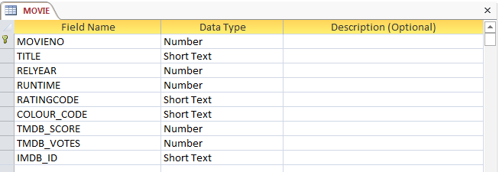
Table Design and Definition
The design view of a table shows details about all fields in a table
Each field has a data type (defines what type of data is allowed to be stored in this field)
We will concentrate on Short Text, Number, Currency & Date this semester
The symbol indicates this field is a Primary Key
In this example, movies are uniquely identified by MOVIENO:

Slide 27
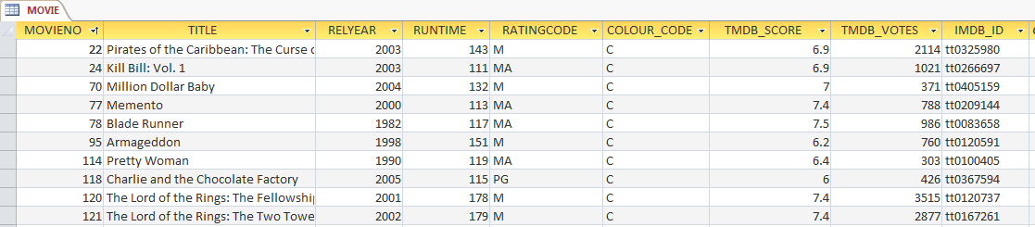
Datasheet View
The datasheet view of a table shows rows in a table
Not all rows can be loaded at once. If a table contained millions of rows, this would not be possible
The datasheet view is dangerous. If you change the contents of a cell and move to a new row, the data is changed permanently. There is no question asking "Do you want to save changes"!

Slide 28
Records/Fields vs. Rows/Columns
Most databases & DB developers use the term Row rather than Record
Access uses the term Record.
Oracle (which we will use later) uses the term Row
We will use them interchangeably during the semester
Most databases & DB developers use the term Column rather than Field
Access uses the term Field.
Oracle uses the term Column
We will use them interchangeably during the semester

Slide 29
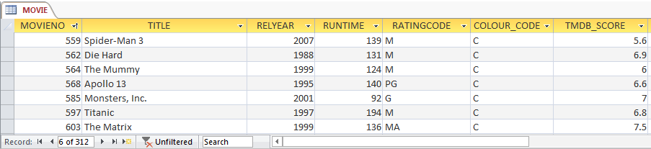
Access Fields and Records
The movie table contains 312 records
Each record contains data about one movie
Each record is made up of many fields.
Table Name
A field
A record

Slide 30
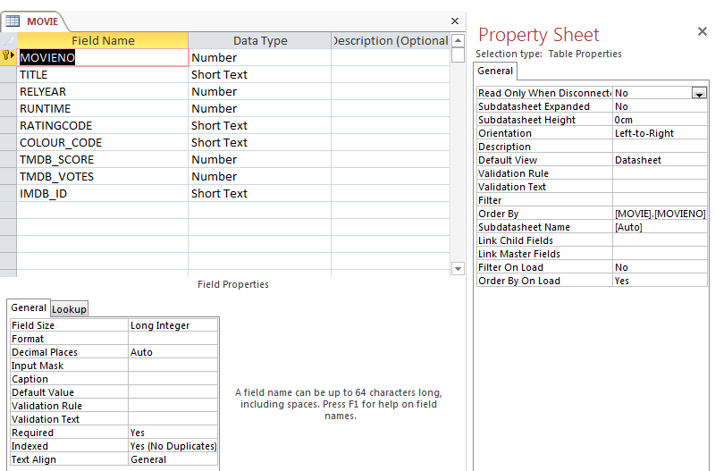
Field Properties and Property Sheet
As you use the Design view of a table, you may see
The Property Sheet
Field Properties
Don't be overwhelmed.
This semester, we will ignore almost all of these settings

Slide 31
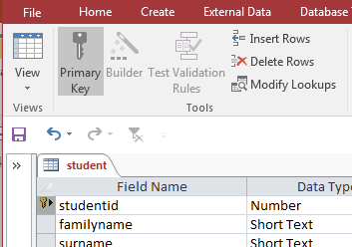
Primary Keys
Every table that you create must have a Primary Key.
While this is optional within Access, any table based on Codd's Relational Model must have a Primary Key.
A Primary Key is a field which will contain a value that is a unique identifier for each record
No duplicates are permitted.
The data should be static. It should be a value that should never need to change. Select a field and then Click the icon

Slide 32
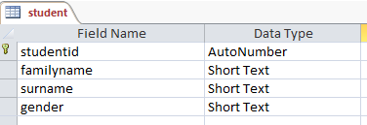
AutoNumber
If you create a table and forget to nominate a Primary Key, Access will ask if you want it to create one for you
Such a key will have a AutoNumber datatype
In such cases, the user would never have to enter a new student number for each student.
Instead Access will simply allocate a sequential numbered value
This is a very useful mechanism
However, avoid using AutoNumber datatypes for the first weeks of the semester.

Slide 33
Filters and Queries
Datasheet Filter | Design Grid | Running | Saving | Reusing

Slide 34
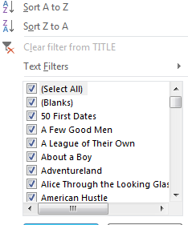
Datasheet Filters
Filters are a useful way of specifying which records are to be retrieved by Access
Click the  icon on any of the Field headings
Simply check one or more of the boxes on the left side of the menu to choose a record
Click Select All toggle to select / unselect all records

Slide 35
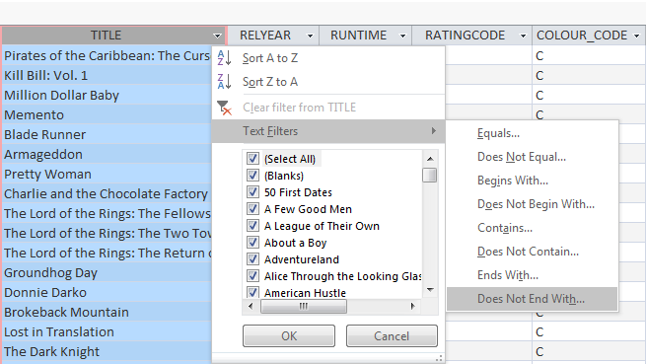
Datasheet Filters (cont.)
Click the Text Filters menu option to specify others filter options

Slide 36
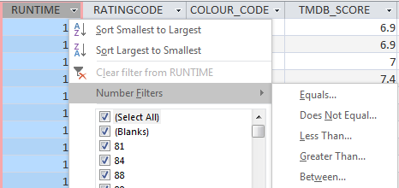
Datasheet Filters (cont.)
Numeric columns have a different selection of filter options

Slide 37
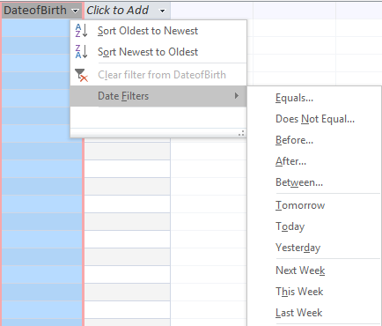
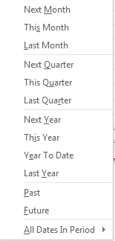
Datasheet Filters (cont.)
Date columns have huge selection of filter options

Slide 38
Filters vs. Queries
Filters are useful for 'one-off' searches
However, Filter settings cannot be saved.
The next time you want to repeat the search, you need to re-create all of the filter settings again.
Queries by comparison are most useful when a search will be repeated.
Filters can be saved as a 'Query'
A query can be re-run repeated may times
A query can behave just like a table.
A new query can use an existing query as its source (instead of a table)

Slide 39
Queries
An Access query is literally a question that you ask about your data
e.g. What is the name and rating code of all movies that were released in the year 2015.
To Build a query think about:
Which table(s) store this data
Which fields do you want displayed
What criteria does a record have to match
What sequence do you want to matching data to appear in

Slide 40
Queries (cont.)
Q: What is the title and rating code of all movies that were released in the year 2015.
Which table are necessary?
Movie table
Which fields do you want displayed
Title, RatingCode
What criteria does a row have to match
Relyear must be equal to 2015
What sequence do you want to matching data to appear in
Alphabetical by title

Slide 41
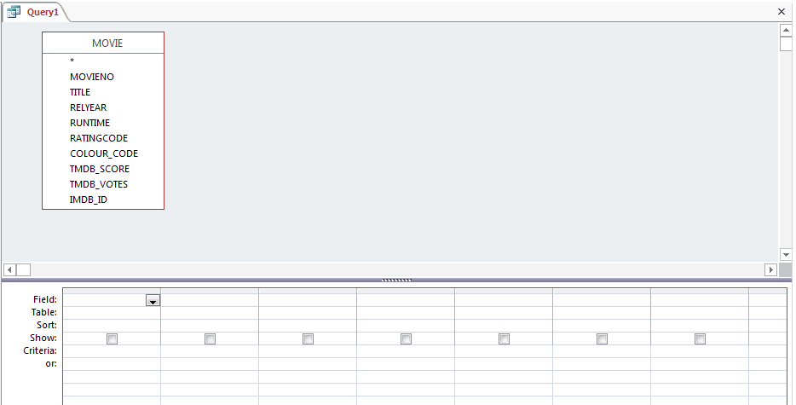
Query Design Grid
Q: What is the title and rating code of all movies that were released in the year 2015?
Query Design Grid

Slide 42
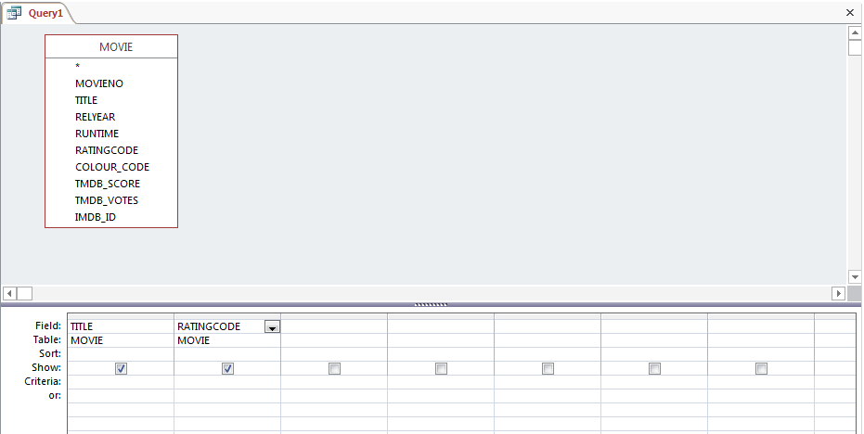
Query Design Grid (cont.)
Q: What is the title and rating code of all movies that were released in the year 2015?
Add each field / column to the Design Grid
(via drag n drop or double click)
The Show check box is selected

Slide 43
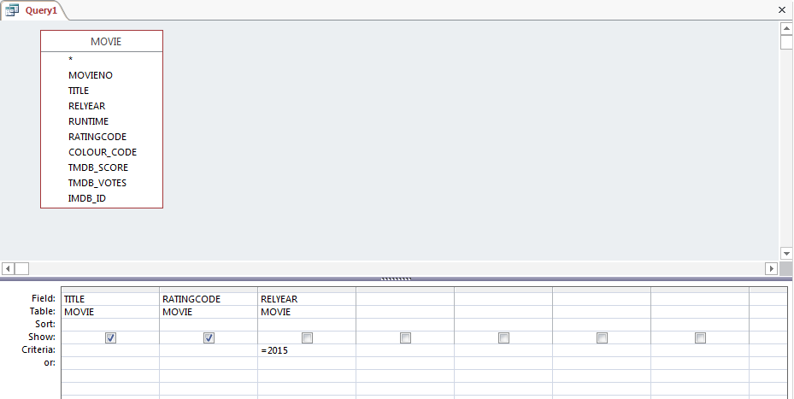
Query Design Grid (cont.)
Q: What is the title and rating code of all movies that were released in the year 2015?
Add the Relyear field / column to the Design Grid
Do not select Show
Specify the criteria that reach row must satisfy

Slide 44
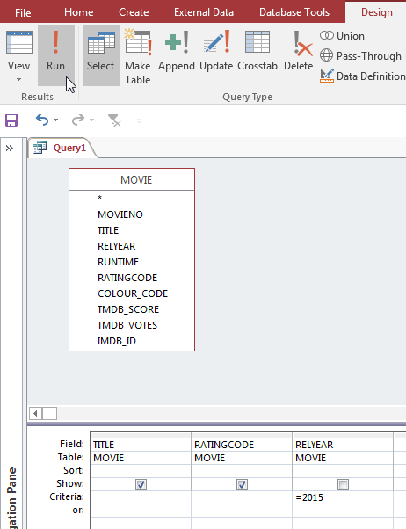
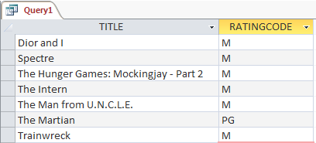
Run the Query
Click the Run ! to execute the query
A Datasheet view appears with the matching rows

Slide 45
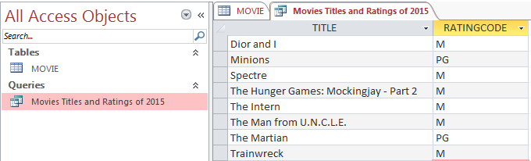
Saving Queries
A Query can be saved and executed again at a later time.
The Query is saved within the database.
This database now contains
A Table named Movie
A Query named Movie Title and Ratings of 2015
To run the query again, simply double click on the Query named Movies Titles and Ratings of 2015.

Slide 46
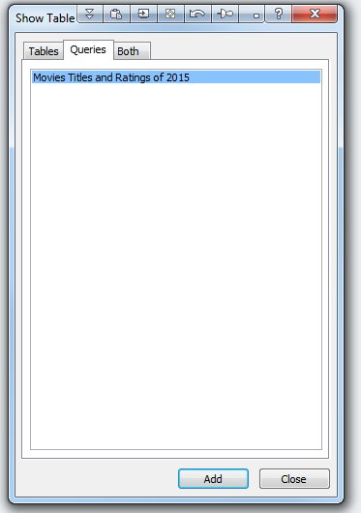
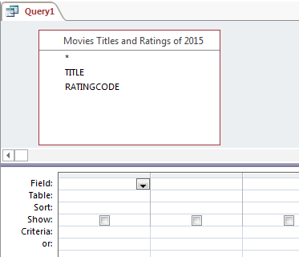
Reusing Queries
Queries are often treated in the same way as Tables within Access
Let us suppose we want to change the criteria
Now, we only want to display PG movies from the year 2015
We could edit and modify the previous query.
Instead… we can create a new query
Create a New Query via Create / Query Design menu option.
Don't base the data on a table but instead choose ‘Movie Titles and Ratings of 2015’ from the Queries tab.
The only columns that are available for this query are Title and RatingCode

Slide 47
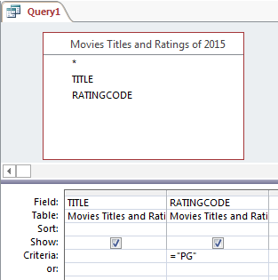
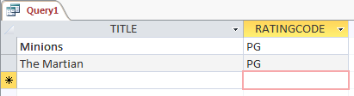
Reusing Queries (cont.)
Add the Title and RatingCode fields / columns to the Design Grid.
Add a criteria to RatingCode so that only PG movies are displayed.
You could save this as a new query.

Slide 48
References on Queries
There are many resources available describing how to create Access Queries
The Access Bible 2016 available on-line via Swinburne Library.
Also:
https://support.office.com/en-us/article/Examples-of-query-criteria-3197228c-8684-4552-ac03-aba746fb29d8?ui=en-US&rs=en-US&ad=US&fromAR=1
https://support.office.com/en-us/article/Use-the-OR-criteria-to-query-on-alternate-or-multiple-conditions-d04b3e63-b477-430e-8fdc-7e37189ede88
https://support.office.com/en-us/article/Examples-of-Access-query-criteria-0c7e9394-c485-454f-bc00-3bd3ec617805
http://www.gcflearnfree.org/access2013/query-criteria-quick-reference-guide/1/
http://www.fontstuff.com/access/acctut06.htm

Slide 49
Multiple Criteria, Keywords, and Wildcards
AND | OR | LIKE | Field Names

Slide 50
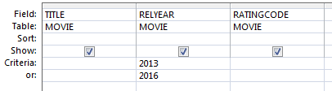
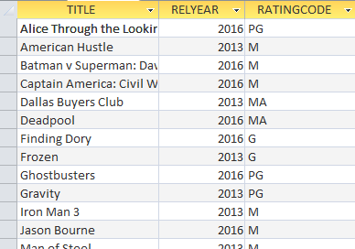
Multiple criteria in a field
When a field has multiple values on multiple rows in the Criteria section, it means that a movie record only needs to satisfy ONE of the criteria
Meaning: Evaluate each record. Select the record when
the relyear is equal to 2013
OR
the relyear is equal to 2016
Either criteria must be met by a record.

Slide 51
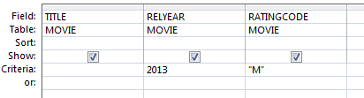
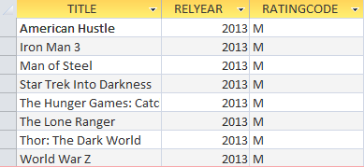
Multiple criteria in multiple fields
When multiple fields have values the Criteria section, it means that a movie record must satisfy ALL of the criteria
Meaning: Evaluate each record. Select the record when
the relyear is equal to 2013
AND
the ratingcode is equal to "M"
Both criteria must be met by a record.
When reading the Criteria across the query it means AND

Slide 52
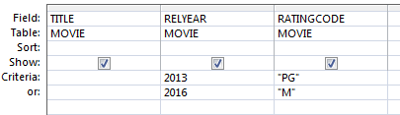
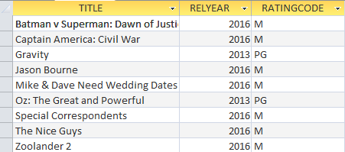
Multiple criteria in multiple fields (cont.)
When multiple criteria rows have multiple values in the Criteria section, it is tricky.
Evaluate each record against each Criteria row separately.
If a record meets all the Criteria of a Criteria Row, then that record is selected.
Meaning Evaluate each record. Select the record when
All of Criteria A is satisfied
OR
All of Criteria B is satisfied
Either criteria A or criteria B must be met by a record.
A
B

Slide 53
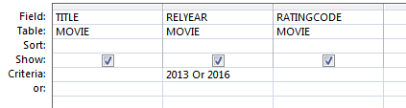
An alternative way to perform OR
You can use the OR keyword instead of using multiple rows in the Criteria area
Meaning Evaluate each record. Select the record when
the relyear is equal to 2013
OR
the relyear is equal to 2016

Slide 54
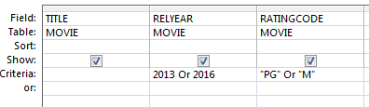
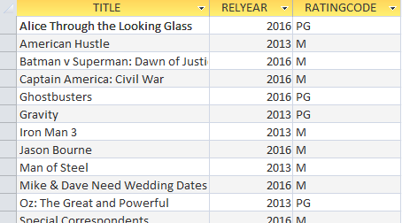
An alternative way to perform OR (cont.)
You can use the OR keyword instead of using multiple rows in the Criteria area
Meaning. Evaluate each record. Select the record when
(the relyear is equal to 2013 OR the relyear is equal to 2016)
AND
(the ratingcode is equal to "PG“ OR the ratingcode is equal to "M")
This means you can have
2013 And PG , 2013 And M
Or 2016 And PG, 2016 and M

Slide 55
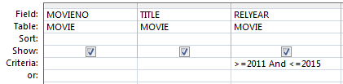
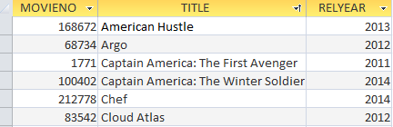
An alternative way to perform AND
You can use the AND keyword in the Criteria area.
It is most useful when defining a numeric range.
Meaning Evaluate each record. Select the record when the relyear is between 2011 and 2015

Slide 56
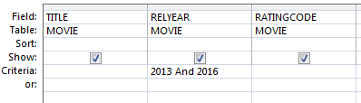

Be carful with AND
Be careful when using AND
Try to understand what you are searching for.
Meaning: Evaluate each record. Select the record when
the relyear is equal to 2013 AND
the relyear is equal to 2016
This is impossible!!!!!
Empty.
No rows match this criteria

Slide 57
Text criteria
When specifying text values in the Criteria section, the text must be surrounded by double quotes
Access is not case sensitive: ”The” is the same as "THE" and "the"
The opposite is true in other databases
In Oracle, "THE" is different to "The" and "the"

Slide 58
Text Wildcards
You can use Wildcards in access
Notice the space after the
If no space then you will get an outcome like “Thelma and Louise”
when you actually want only Titles that start with THE
These must be used with the ‘Like’ keyword
The Like condition allows you to use wildcards to perform pattern matching
The patterns that you can use are:
Wildcard | Description | Example | Explanation
* | Allows a match of any string of any length | Like "the *" | Title must begin with "the"
 |  | Like "*day*" | Title must contain day
? | Allows a match on a single character | Like "the ????" | Title must begin with "the" and be followed by exactly 4 characters

Slide 59
Field Names
When creating field names
Avoid using spaces
Use letters A-Z, a-z, and numbers 0-9
In queries you will often see examples of field names surrounded by square brackets
e.g. [movieno] [title] [relyear]
This was introduced because Access allows you create field names that contain spaces! (Please avoid doing this! Leads to headaches).
Using [ ] is the only way to tell Access the start and end charters of a field name

Slide 60
Tasks based on Week 1 Lecture
There are tutorial questions and submission tasks associated with this lecture.
The tutorial questions…
Should be reviewed by students after this lecture
They will be discussed in the tutorial.
Tutorial usually discus topics from the previous week's lecture
Topics discussed in the above sessions may appear in tasks and in tests
The submission tasks…
Can be completed in your own time( remember to check deadlines)
You will need MS Access for the first few weeks of the semester
The completed tasks must be submitted via Canvas

Slide 61
End.
Thanks for viewing the recording. Good luck this Semester ☺.

